Slide 1
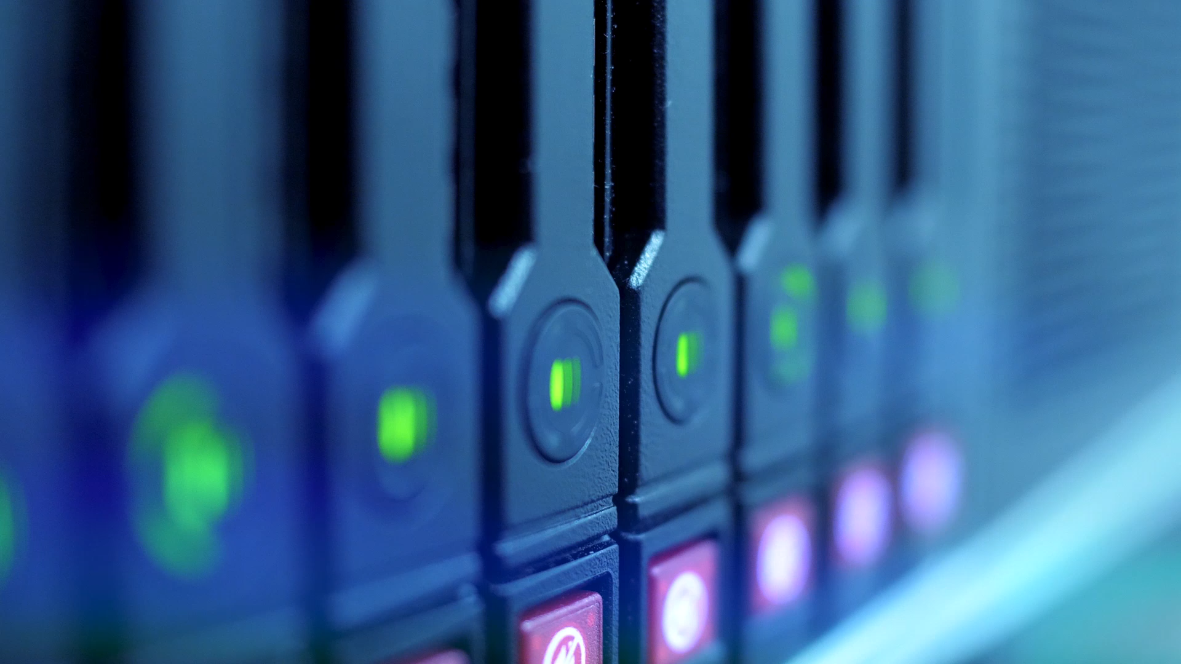
Windows Server Hardening
Groups
Syed.,
Ajisola Akinsuroju
Joemar Lugtu

Slide 2

Abstract
This report delves into the critical process of system hardening, a cybersecurity practice aimed at fortifying computer systems against potential vulnerabilities and attack vectors. The focus is on the implementation of system hardening standards, particularly those provided by the National Institute of Standards and Technology (NIST) and the Center for Internet Security (CIS). The report zooms in on the selection of Windows Server within a small IT firm, emphasizing its pivotal role in managing critical operations and client data. By leveraging the CIS benchmarks for Windows Server, the goal is to establish a secure baseline and mitigate various potential threats, such as unauthorized access, malware, insider threats, and more. The report outlines the comprehensive risk management approach, specific controls for implementation, challenges faced, and recommendations for a small IT firm navigating the dynamic cybersecurity landscape.

Slide 3
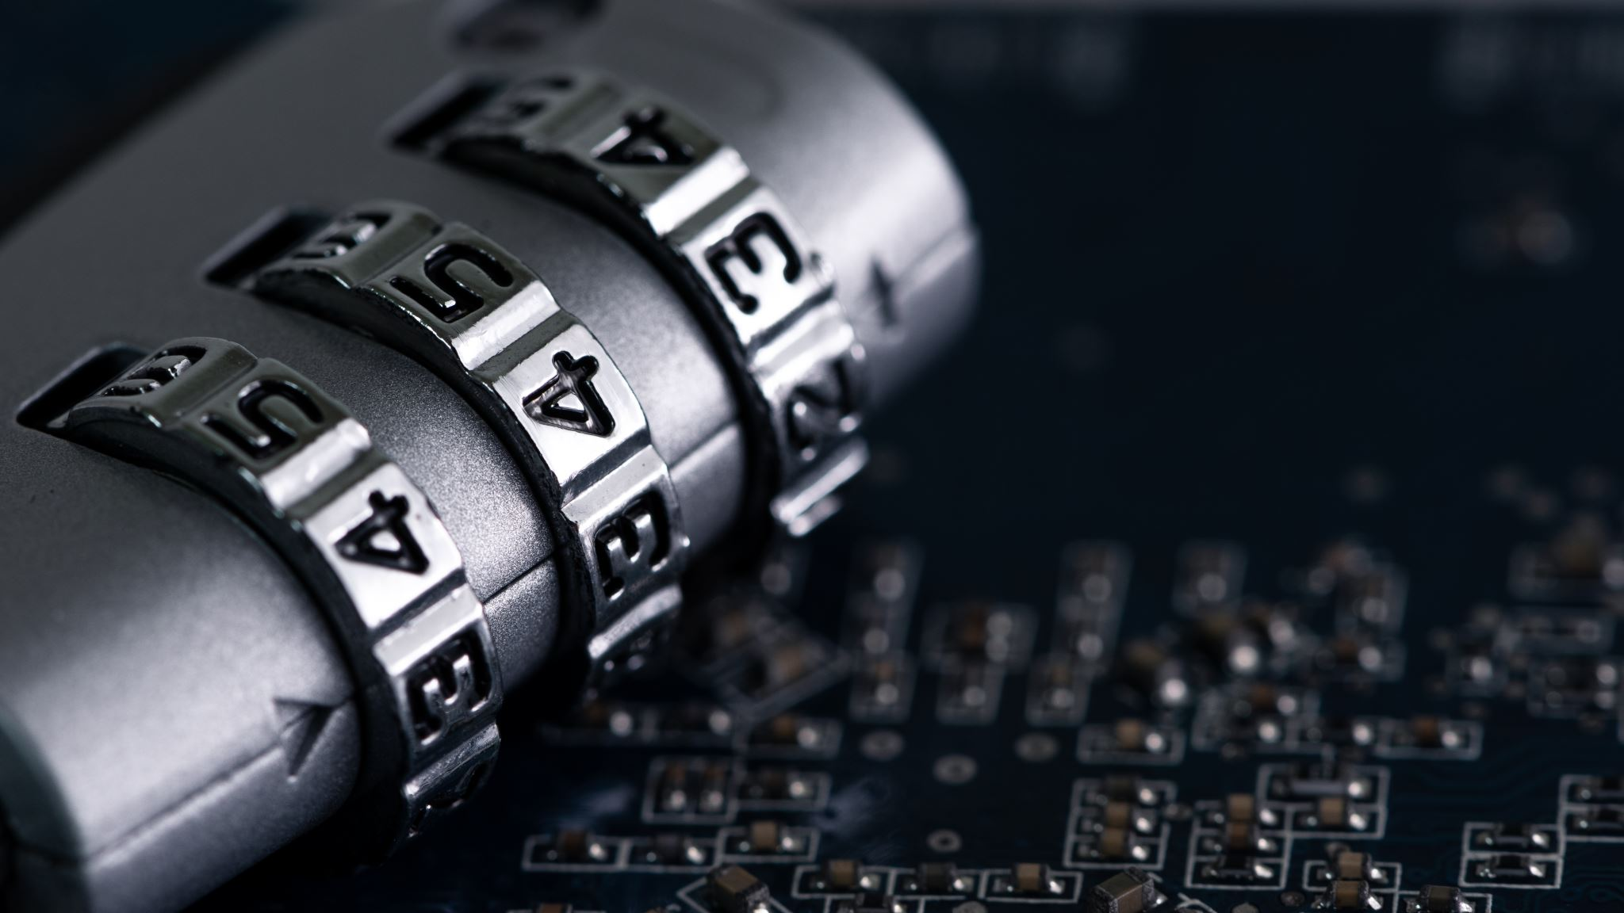
Introduction
System hardening, as defined by the National Institute of Standards and Technology (NIST), serves as a foundational cybersecurity process designed to minimize a computer system's vulnerability and potential attack vectors. This report focuses on the practical application of system hardening standards, specifically within the context of a small IT firm relying on Windows Server. The selection of Windows Server underscores its critical role in the firm's operations, housing sensitive data and critical applications. By adopting the CIS benchmarks for Windows Server, the objective is to establish a robust security posture, adhering to best practices and guidelines that cover aspects such as access controls, network security, and system settings. This report navigates through the system hardening process, detailing implementation steps, risk management strategies, and the significance of comprehensive documentation.

Slide 4
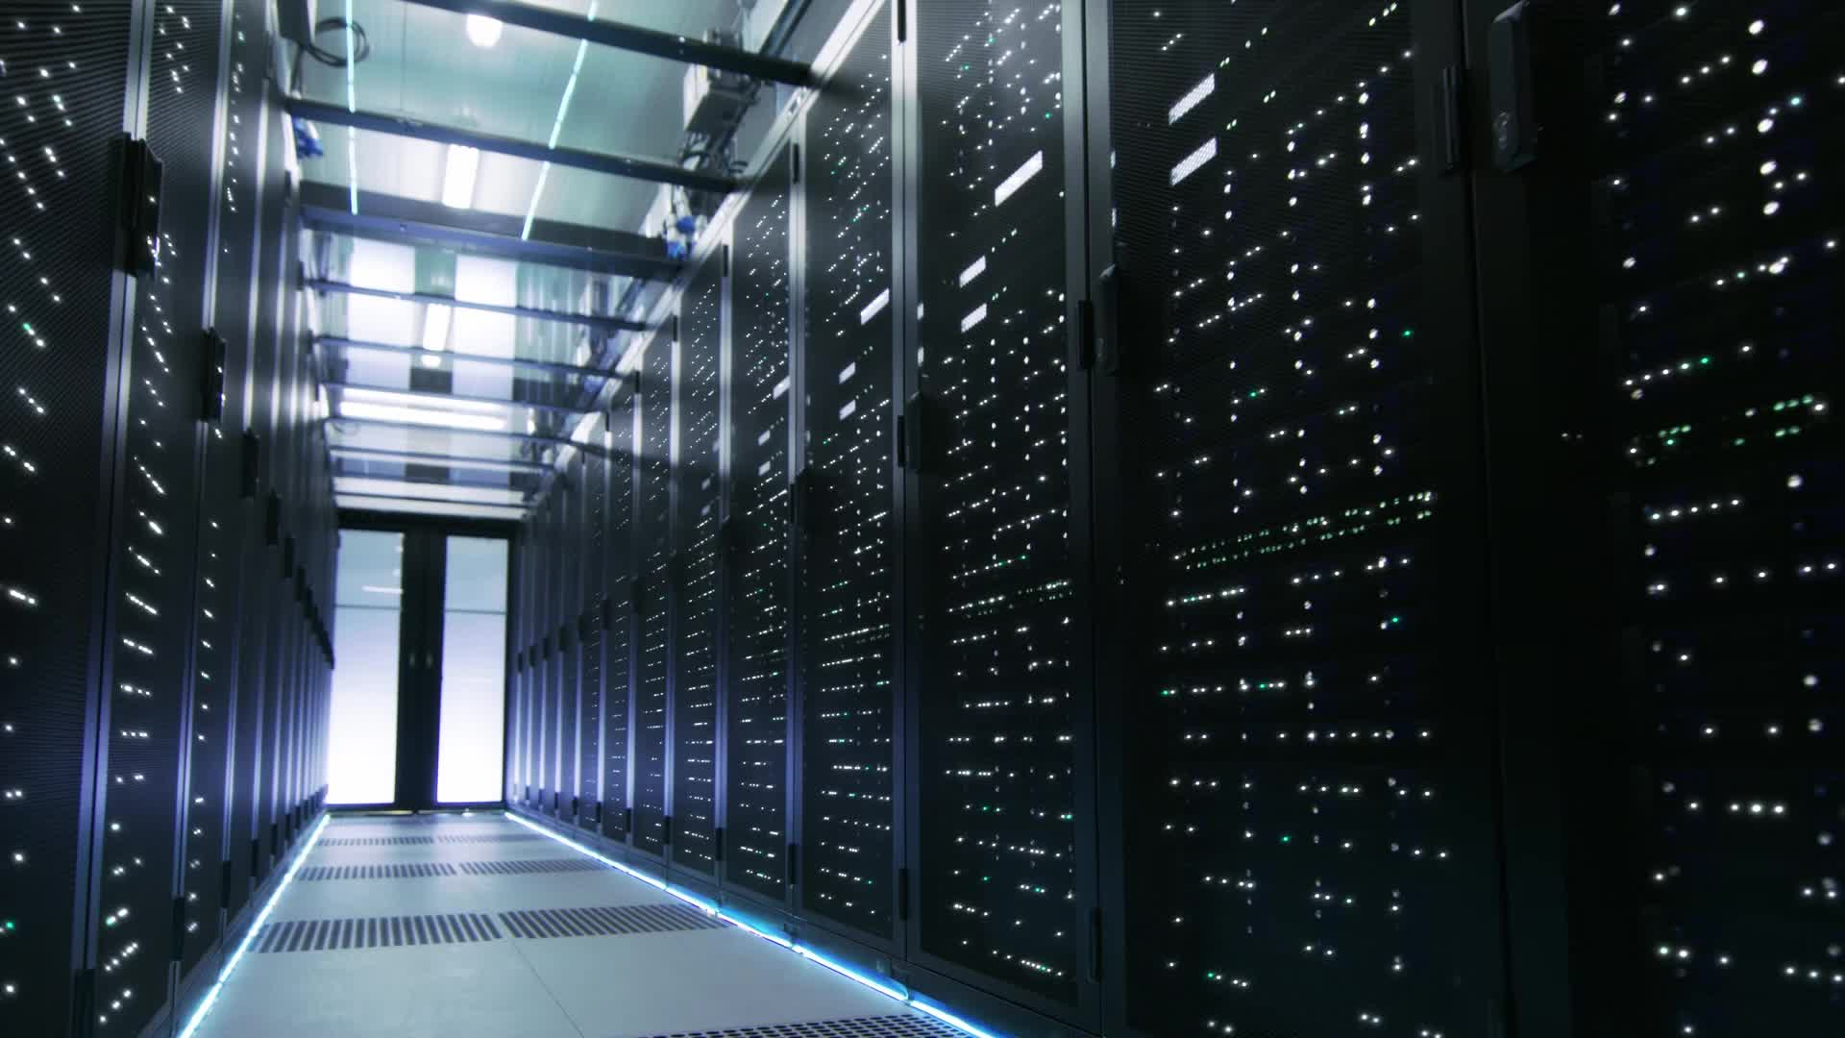
System Selection: Windows Server in a Small IT Firm
In selecting the Windows Server as the focal point for security enhancements, it is crucial to recognize its pivotal role within a small IT firm. This server likely acts as the backbone for various operations, housing critical business applications, managing client data, and serving as a central hub for network activities. Given these responsibilities, the need to fortify its security posture becomes imperative to ensure the confidentiality, integrity, and availability of sensitive information.

Slide 5
Threats and Risks: A Comprehensive Analysis
Specific aspect | Threat | Risk | Risk Mitigation
Unauthorized Access | Malicious actors seeking unauthorized access. | Confidentiality and integrity of sensitive data compromised potential disruptions to critical services. | Implement robust authentication mechanisms, enforce strict access controls, and limit user privileges based on job roles.
Malware and Ransomware | Introduction of malicious software compromising server integrity. | Data integrity and operational continuity at risk, leading to data loss, service disruptions, and financial losses. | Deploy robust antivirus software, ensure regular updates and patches, and conduct user education programs on safe computing practices.
Insider Threats | Malicious intent from employees or insiders. | Compromise of data through unauthorized access or intentional manipulation. | Implement continuous monitoring of user activities, apply the principle of least privilege, and conduct regular employee training on security policies.
Data Interception and Eavesdropping | Unencrypted data transmission over the network can be intercepted. | Confidentiality of business communications and transactions jeopardized. | Implement encryption protocols like SSL/TLS, regularly monitor network traffic to detect anomalous patterns indicative of eavesdropping attempts.
Denial of Service (DoS) Attacks | Deliberate attempts to overwhelm the server. | Disruption of services, downtime, and potential financial losses. | Implement robust firewalls, intrusion detection systems, and ensure load balancing and network redundancy for resilience against DoS attacks.
Physical Security Risks | Physical compromise of the server, theft, or unauthorized access to server rooms. | Unauthorized access, data theft, or tampering of server hardware. | Secure server rooms with access controls, surveillance, and entry logs. Implement hardware locks and tracking systems for additional deterrence.
Software Vulnerabilities | Exploitation of software vulnerabilities in the Windows Server's operating system or applications. | Unauthorized access, malware installation, compromise of system integrity. | Establish a rigorous patch management process, conduct regular vulnerability assessments, and perform penetration testing to identify and address potential weaknesses.

Slide 6
Challenges and Recommendations
3.1 Challenges Encountered
Resource Constraints: The small IT firm faced challenges in allocating dedicated resources for the implementation and ongoing monitoring of security controls.
User Training: Ensuring that all personnel were aware of and compliant with the new security measures proved to be a significant challenge.
3.2 Recommendations
Resource Allocation: Allocate dedicated resources for ongoing monitoring, maintenance, and updates of security controls. This could involve hiring additional staff, outsourcing certain functions, or investing in automated security solutions.
Training and Awareness Programs: Conduct regular training and awareness programs to ensure all personnel are well-informed about security policies, best practices, and their role in maintaining a secure IT environment.

Slide 7

Conclusion
In conclusion, this report highlights the significance of system hardening as a proactive cybersecurity measure, particularly within the operational landscape of a small IT firm relying on Windows Server. By implementing CIS benchmarks, the organization aims to fortify its security posture, mitigating threats ranging from unauthorized access to malware and insider risks. The comprehensive risk management approach outlined in this report emphasizes regular security audits, incident response planning, and continuous monitoring to ensure resilience in the face of evolving cyber threats. Despite challenges such as resource constraints and the need for user training, the report offers recommendations to overcome these hurdles and sustain a robust security framework. Through adherence to system hardening standards and continuous improvement, the small IT firm aims not only to protect its critical assets but also to instill confidence in clients and stakeholders regarding its commitment to cybersecurity best practices.

Slide 8
References
Center for internet security. (n.d.). https://downloads.cisecurity.org/
Daniel, B. (2023, February 28). System hardening: An easy-to-understand overview. Trusted Computing Innovator. https://www.trentonsystems.com/blog/system-hardening-overview
Nepal, A. (2013, August). (PDF) Linux Server & Hardening Security - ResearchGate. https://www.researchgate.net/publication/265162827_Linux_Server_Hardening_Security
Obidinnu, J., & Ibor, A. (2015, October). System hardening architecture for safer access to Critical Business Data. https://www.researchgate.net/publication/297680370_System_Hardening_Architecture_for_Safer_Access_to_Critical_Business_Data
Wayburn, J. (2023, November 21). System hardening guidelines: Critical best practices. Perception Point. https://perception-point.io/blog/system-hardening-guidelines-for-2022-critical-best-practices/
What is server hardening? how to secure server workloads. SOPHOS. (2023, December 14). https://www.sophos.com/en-us/cybersecurity-explained/what-is-server-hardening

